Slide 1

VECTO 2.0 15.04.2014
Update Notes

Slide 2
VECTO 2.0
Incompatible changes since previous release (V1.4):
File-format changes for Input/Output files
Old file-formats scrapped; CSV and JSON used everywhere
CSVs: Use "#" for comments , one and only one header-line required
Important additions and enhancements:
Declaration Mode
Sets generic parameters for calculation
Locks non-user input parameters in GUI
Updated GUI for new parameters and charts
New internal visualizer for fast post processing (replaces closed external tool GRAPHi)
WHTC Correction
Start/Stop auxiliary correction

Slide 3
File-format changes
Old format scrapped; only JSON and CSV is supported
CSVs: New comment symbol is "#" (instead of "c“)
CSVs: One and only one header-line is required (which must not be a comment line)
The formats are described in the HTML User Manual under “Input and Output Files” > “CSV Format” and in each input file page of the user manual.

Slide 4
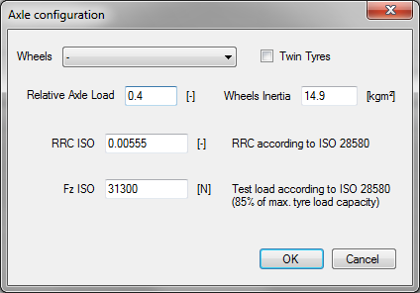
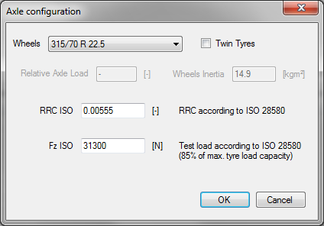
Declaration Mode
Declaration Mode is (de-)activated in the GUI as global parameter, i.e. is active for all following calculations
When active all non- user-input parameters are locked
Example: Axle configuration in vehicle file:
Declaration Mode OFF (Engineering Mode)
Declaration Mode ON
Relative axle load and wheels inertia are user-defined
Relative axle load is set according to HDV class and mission profile.
Wheels inertia depends on selected wheels

Slide 5
Declaration Mode
Automatic assignment of generic values
Examples:
Mission profiles ...based on HDV class
Loading ...based on HDV class and mission profile
Trailer RRC & weight ...based on HDV class and mission profile
Shift polygons ...based on full load curves
Engine inertia ...based on engine displacement

Slide 6
Start/Stop FC Correction
Auxiliary power demand is constant for the whole mission profile but when Start/Stop is enabled there is no idling consumption. Therefore:
Reduced engine-on time has to be considered
Auxiliary energy balance must be equal to vehicles without Start/Stop

Slide 7
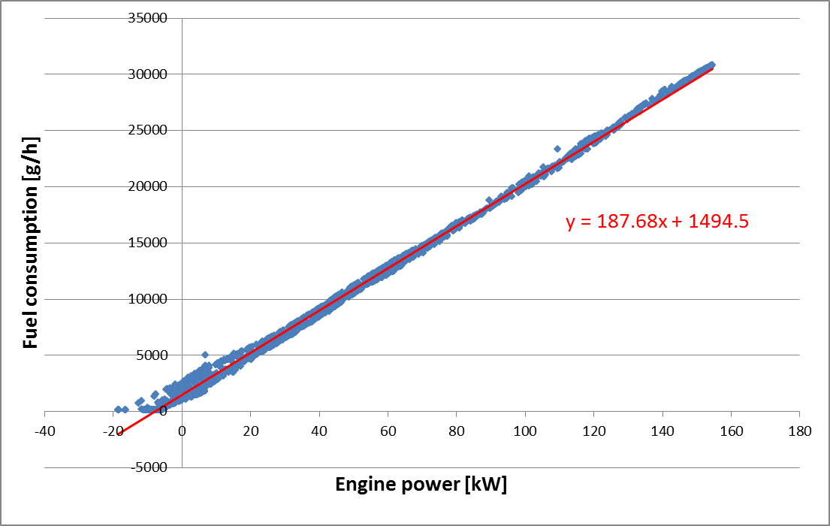
Start/Stop FC Correction
VECTO Start/Stop FC Correction:
From all 1Hz data points of the VECTO simulation, a linear regression curve (y=k*x+d) for fuel consumption (g/h) over engine power (kW) is calculated.
From the difference between the energy consumed by the auxiliaries in the simulation with Start/Stop function and the target value (kWh), a cycle average change in mechanical power “ΔPe” (kW) of the internal combustion engine is calculated.
The correction of the fuel consumption is performed for all 1Hz time steps using ΔFC (g/h) = ΔPe * k
The correction considers the use of brake energy, hence ΔFC=0 if braking power ≥ ΔPe

Slide 8
WHTC Correction
WHTC measurement results are defined in the Engine File
VECTO calculates WHTC with stationary FC map
Correction factor is calculated as measurement / calculation ratio using weighting factors
The correction factor is multiplied to the VECTO FC results
CF_{WHTC} = WHTC Correction Factor [-]
i = index for each part (Urban, Rural, Motorway)
f_{i} = Weighting factor per part [-]
FC_{meas_i} = WHTC measurement result per part (input parameter) [g/kWh]
FC_{calc_i} = Calculated FC per part [g/kWh]

Slide 9
Full Changelog V2.0
Bugfix: FC extrapolation will not abort calculation. Invalid FC values are marked in output as "ERROR"
Updated CSV file format. Now only one header with units included
Changed input file comment symbol form "c" to "#"
Replaced old Demo/Default Data with "Demo Vehicles"
Updated User Manual
Introduced Declaration Mode
Updated GUI including Charts
New internal Graph for VMOD files (replaces GRAPHi)
Shift polygons can be set separately for each gear
Removed rated power (not used anymore)
Removed rated engine speed form engine file. Now calculated form vfld file.

Slide 10
VECTO 1.4 RC4
10.10.2013
Update Notes

Slide 11
VECTO 1.4
Update Overview:
Eco-Roll and Look-Ahead Coasting revised
Major update in Gearbox/Torque Converter
Engine Only Mode: Engine motoring points can be defined explicitly in load cycle
Full load and drag curves (.vfld) can be defined for each gear separately
Load-dependent rolling resistance coefficients
Start-Stop activation delay time can be defined in job file
Various bug fixes and optimisations

Slide 12
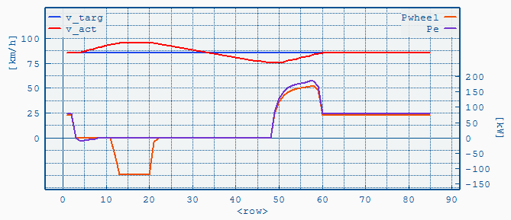
Eco Roll
New rules for Eco Roll (de-)activation:
Activation if P_{wheel}* < 0
Deactivation if Underspeed is reached
Underspeed
reached
P_{wheel}<0
Eco Roll activated
Eco Roll deactivated
* P_{wheel} = Total power demand at wheels

Slide 13
Look-Ahead Coasting
Real coasting also if road gradient > 0
Deceleration may be so high that no braking is necessary. In this case the braking phase will be omitted. (Before V1.4 coasting was not affected by road gradient, if > 0)
Distance Correction now also affects coasting phases
Lower distance error
Coasting phases may be interrupted temporary to correct distance

Slide 14
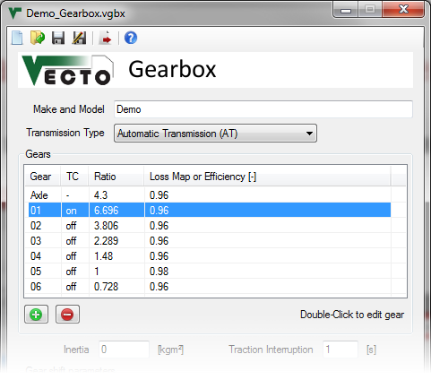
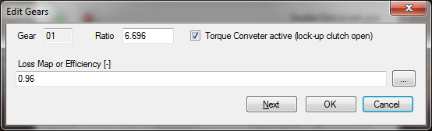
Gearbox & Toque Converter
Torque converter can now be defined in multiple gears
Double-click to edit gear
Note: Old Gearbox files (V1.3.1) are compatible with V1.4

Slide 15
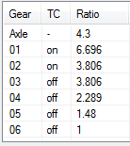
Gearbox & Toque Converter
Example: Torque converter active in first and second gear
Gear 1 = First mechanical gear with TC active*
Gear 2 = Second mechanical gear with TC active
Gear 3 = Second mechanical gear with TC inactive
Gear 2 and 3 are the same mechanical gear (same gear ratio)
Note: Gear numbers in results are the same as here (i.e. no more "0.5" gear)!
* TC active = lock-up clutch open

Slide 16
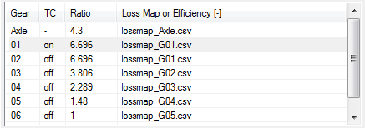
Toque Converter Setup
Conventional Automatic Transmission
Torque converter file is defined for torque converter only
Define TC gear with ratio of first (mechanical) gear
Set transmission losses of first gear (map or constant efficiency)
MP1000
Engine
Torque Ratio μ = T_{out} / T_{in}
TC
Speed Ratio ν = n_{out} / n_{in}
Gearbox Out
n_{out}, T_{out}
n_{in}, T_{in}
Torque Converter file (.vtcc)
= Gearbox In

Slide 17
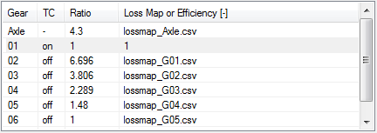
Toque Converter Setup
Power-distributed Automatic Transmission
Torque converter file is defined for the whole gearbox
Define TC gear with ratio = 1
Set transmission efficiency to 1 (= 100%) because losses are covered by .vtcc file
MP1000
Engine
Torque Ratio μ = T_{out} / T_{in}
TC
Speed Ratio ν = n_{out} / n_{in}
n_{out}, T_{out}
n_{in}, T_{in}
Torque Converter file (.vtcc)
= Gearbox Out
= Gearbox In

Slide 18
Gearbox & Toque Converter
More changes:
Same gear numbers in output as in GBX file, i.e. first gear with TC is not "TC" or "0.5" but simply "1"
"Minimum time between two gear shifts" now also limits torque converter shifts
Unlimited number of gears and new gear list in GUI without fixed gear number
Improved gear shift model for torque converter
Driving Cycle Preprocessing and Gear Shift Model now use approximated efficiency values based in the transmission loss maps.
Reduces calculation time significantly with little to no impact on fuel consumption.

Slide 19
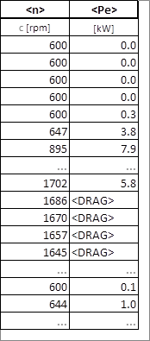
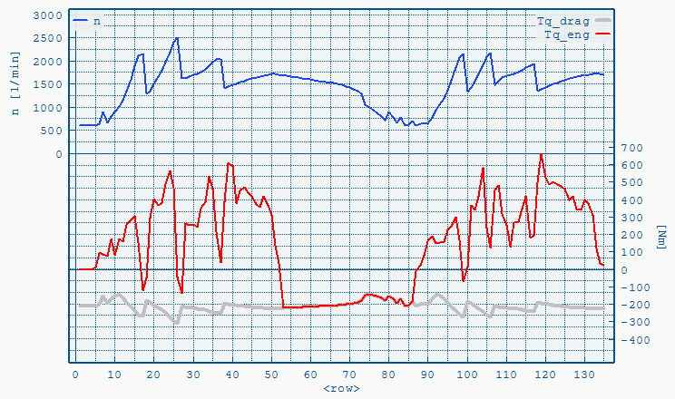
Motoring in Engine Only Mode
Engine motoring points can be defined explicitly in load cycle by using the <DRAG> keyword
Engine Speed
Load cycle (.vdri)
Engine Torque
Drag Torque from .vfld file

Slide 20
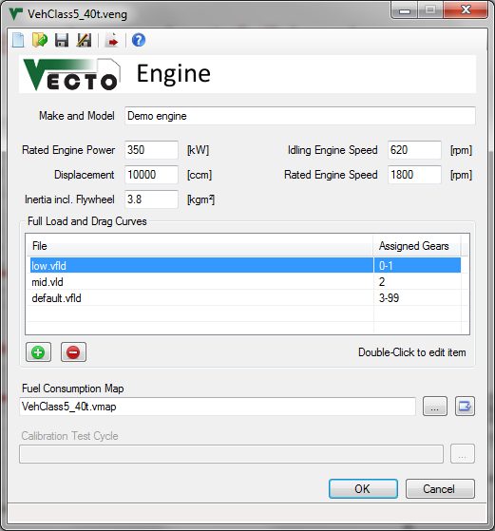
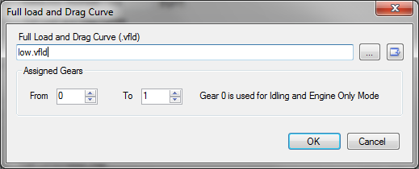
Gear-dependent full load curves
Each .vfld file can be assigned to a single gear or a range of gears
Double-click to edit
Note: Old Engine files (V1.3.1) are compatible with V1.4

Slide 21
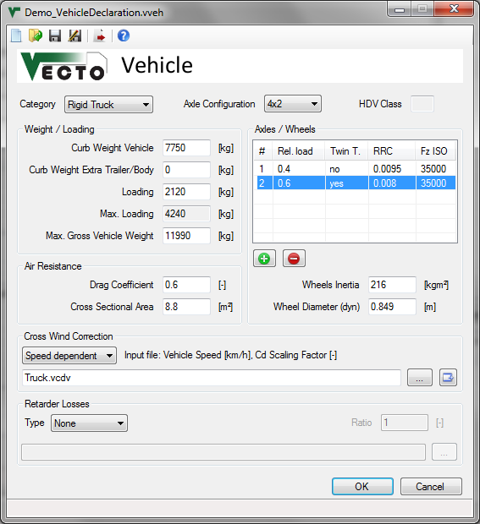
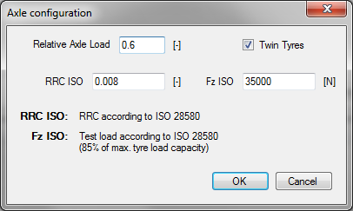
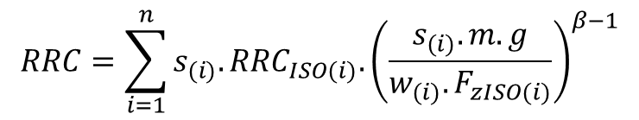
Load-dependent rolling resistance coefficient
For each axle the RRC* and test load F_{z}* are defined
Twin Tyres => nr. of wheels w_{(i)}
yes => w_{(i)} = 4
no => w_{(i)} = 2
Relative axle load s_{(i)}
(share of total weight)
F_{zISO(i)}*
RRC_{ISO(i)}*
Double-click to edit axle config.
Total RRC calculation
m [kg] = total vehicle weight
g [m/s²] = 9.81
β [-] = 0.9
* according to ISO 28580 (Test load: 85% of max. load capacity)

Slide 22
File Signing
File signing ensures that...
result files were actually created by VECTO and not modified afterwards
files were not changed after signing
specific input files were used for calculation
a file's origin (license owner) is traceable

Slide 23
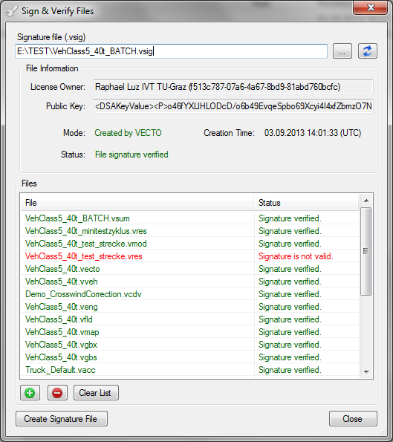
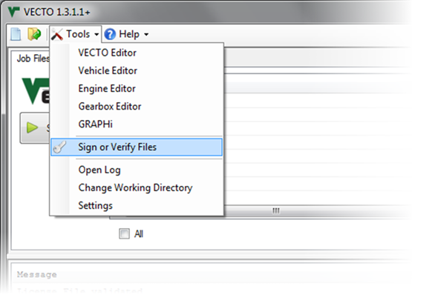
File Signing
After each calculation a signature file (.vsig) is created which includes signatures for all input and result files. The file itself is also signed.
Signature files can be verified or manually created under "Tools" > "Sign or Verify Files"
When verifying it can be checked if the file was automatically or user-created. (Automatically created files include input and result file signatures.)

Slide 24
Full Changelog V1.4 (1/3)
VECTO 1.4
Bugfix: FC interpolation failed when load points matched map points exactly.
Bugfix: Invalid "FC= -10000!" errors when outside of FC-Map
Bugfix: Vehicle stand-still at end of cycle was ignored (distance-based cycles only)
Bugfix: Distance Correction didn't work right with Look Ahead Coasting. Now distance error is acceptable but at the cost of partly interrupted coasting phases. Should be revised in future updates.
FC extrapolation will not abort calculation. Invalid FC values are marked in output as "ERROR".
No abortion if transmission output and input torque have different signs (In>0, Out<0). (Caused "Transmission Loss Map invalid" error messages)
Eco-Roll revised. New rules:
Engages if Pwheel < 0
Disengages if Underspeed is reached.
Look-Ahead Coasting now uses real coasting also if road gradient > 0 which means the coasting deceleration can be so high that no braking is necessary. In this case the braking phase will be omitted and the total deceleration time can be shorter than expected by the given target coasting deceleration.
"Minimum (actual) speed" instead of "Min. Target Speed" for Eco-Roll, Overspeed and Look Ahead Coasting
Load-dependent rolling resistance coefficient

Slide 25
Full Changelog V1.4 (2/3)
VECTO 1.4 (cont.)
Major update in Gearbox/Toque Converter:
Torque converter can be defined in multiple gears
Same gear numbers in output as in GBX file, i.e. first gear with TC is not "TC" or "0.5" but simply "1"
"Minimum time between two gear shifts" now also limits torque converter shifts
Unlimited number of gears and new gear list in GUI without fixed gear number
Improved gear shift model for torque converter
Driving Cycle Pre-processing and Gear Shift Model now use approximated efficiency values based in the transmission loss maps. Reduces calculation time significantly with little to no impact on fuel consumption.
Full load and drag curves (.vfld) can be defined for each gear separately.
Engine Only Mode: Engine motoring points can be defined explicitly in load cycle with "<DRAG>"
When speed is under 5km/h and engine in motoring operating then gearbox shifts to Neutral
Start-Stop activation delay time can be defined in job file
File signing features added:
After each calculation a signature file (.vsig) is created which includes signatures for all input and result files. The file itself is also signed.
Signature files can be verified or manually created under "Tools" > "Sign or Verify Files"

Slide 26
Full Changelog V1.4 (3/3)
VECTO 1.4 (cont.)
Changes in header and new parameters in modal results (.vmod):
engine speed => n
torque => Tq_eng
Pe => Pe_eng
New: Tq_clutch = torque at clutch (before clutch, engine-side)
New: Tq_full = full load torque
New: Tq_drag = drag torque
Removed: Pe_norm, n_norm
Changes in summary results (.vsum)
Total altitude change instead of average gradient
Auxiliary energy consumption for each auxiliary
Removed: Pe_norm, n_norm
Same job file list for BATCH and STANDARD (Job file list does not change when switching mode)
Updated some error messages (units)
Driving Cycle stop times corrected (No more zero stop times).

Slide 27
VECTO 1.3.1
16.05.2013
Update Notes

Slide 28
VECTO 1.3.1
Update Overview (since V1.0):
Driver Model:
Overspeed
Eco-Roll
Look Ahead Coasting
New Gear Shift Model
Shifting based on used-defined shift polygons
Sequential shifting or gear skipping
Optional shifting inside polygons
Start gear calculation
Torque Converter Calculation
Engine Only Mode
Engine Start/Stop
Visualizer (GRAPHi)
User Manual updated with function descriptions
Error messages linked to user manual
Demo Data updated

Slide 29
Driver Model
Overview:
Overspeed
If Pwheel < 0: Coasting with brakes not applied for speed < target speed + allowed overspeed
Eco-Roll
If Pwheel < 0: Neutral gear, engine idling.
Engine and service brake if target speed + allowed overspeed is reached.
Normal driving if target speed + allowed underspeed is reached.
Look Ahead Coasting
Phase of coasting put in front of braking phases

Slide 30
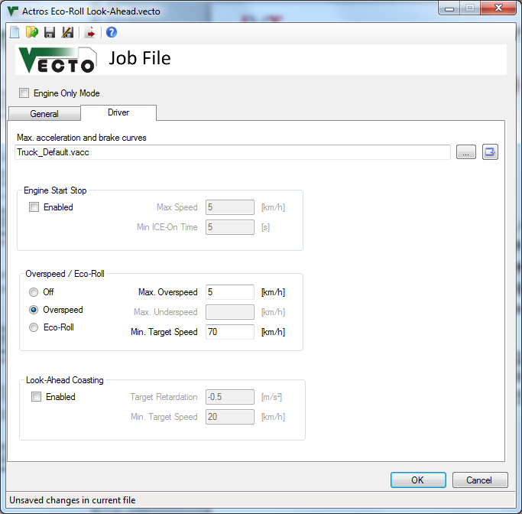
VECTO Editor - Driver Tab
Overspeed:
Functionality:
If P_{wheel} < 0: Coasting with brakes not applied for speed < target speed + allowed overspeed
Parameters:
Minimum Target Speed, e.g. 70km/h
Allowed Overspeed, e.g. 5km/h

Slide 31
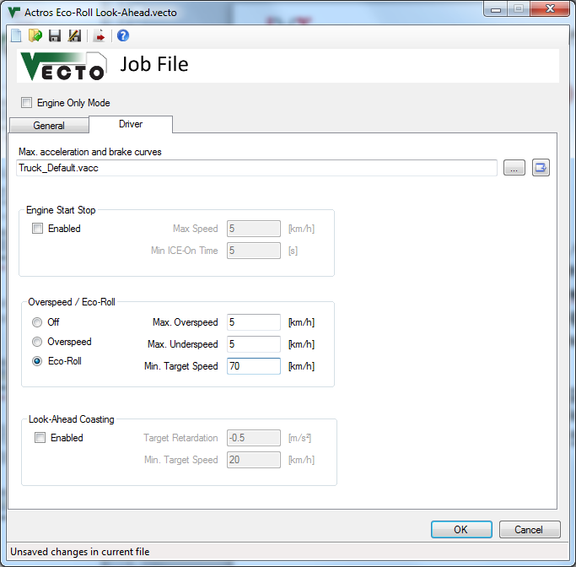
VECTO Editor - Driver Tab
Eco-Roll:
Functionality:
If P_{wheel} < 0: Neutral gear, engine idling.
Engine and service brake if target speed + allowed overspeed is reached.
Normal driving if target speed + allowed underspeed is reached.
Parameters:
Minimum Target Speed, e.g. 70km/h
Allowed Overspeed, e.g. 5km/h
Allowed Underspeed, e.g. 5km/h

Slide 32
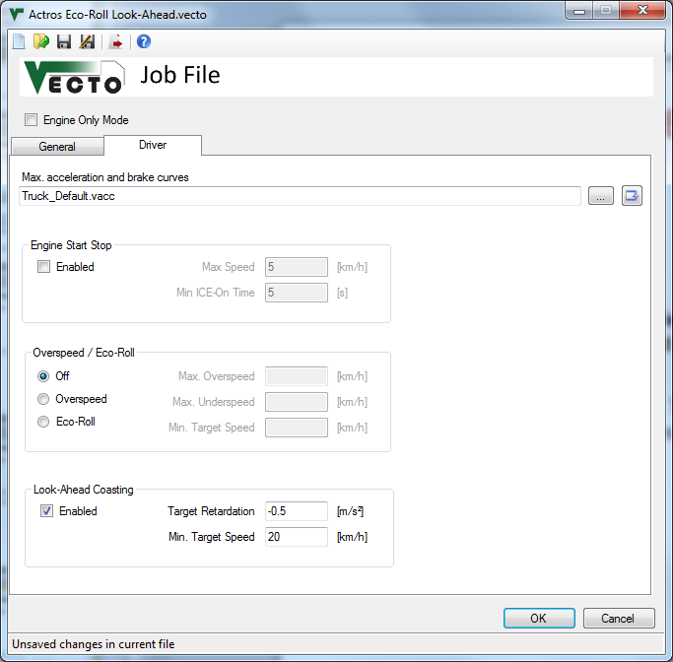
VECTO Editor - Driver Tab
Look-Ahead Coasting:
Functionality:
Phase of coasting put in front of braking phases
Parameters:
Reference (target) deceleration,
e.g. -0.5m/s²
Minimum speed, e.g. 55km/h (e.g. might be used for citybus driving)

Slide 33
VECTO 1.2
09.04.2013
Update Notes

Slide 34
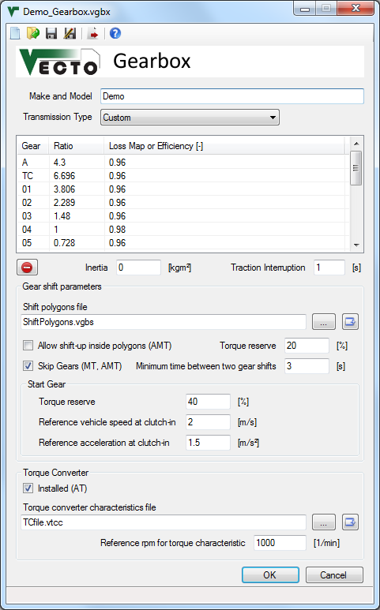
Gearbox updates
Overview:
Default settings for each transmission type
Torque Converter implemented
(Shift Polygons are described in the 1.1 beta Update Notes attached below)

Slide 35
Gearbox updates
Transmission Type:
Manual Transmission (MT):
Activates the "Skip Gears" option. No torque converter.
Automated Manual Transmission (AMT)
Activates the "Allow shift-up inside polygons" and "Skip Gears" option. No torque converter.
Automatic Transmission (AT)
Torque converter ist set and must be parameterized.
Custom
Enables all options for user-defined settings.

Slide 36
Gearbox updates
Torque Converter (TC):
"Installed" can only be changed if Transmission Type is "Custom"
The torque converter is only used in the first gear (TC), i.e. the lock-up clutch is open. After TC comes gear 1(first gear with closed lock-up clutch).

Slide 37
Gearbox updates
Torque Converter characteristics file (.vtcc):
Defines:
torque ratio (= Output Torque / Input Torque) and
input torque at reference engine speed
over speed ratio (= Output Speed / Input Speed)
Must include data for motoring (speed ratio > 1)!
c Speed Ratio ν | Torque Ratio μ | Input Torque at reference rpm
c [-] | [-] | [Nm]
0 | ... | ...
0.1
... | ... | ...
>1! | ... | ...
*VECTO CSV Format:
List Separator: Comma ","
Decimal-Mark: Dot "."
Comments/headers: "c" at the beginning of the comment line. Number and position of comment lines is not limited.

Slide 38
Gearbox updates
Reference rpm for torque characteristic:
Needed to calculate the actual engine torque
Calculation of engine torque (if lock-up clutch is open, gear "TC"):
with:
T_{in} = engine torque [Nm]
T_{ref(ν)} = reference torque at reference rpm (form .vtcc file) [Nm]
n_{in} = engine speed [1/min]
n_{ref} = reference rpm (from .vgbx file) [1/min]

Slide 39
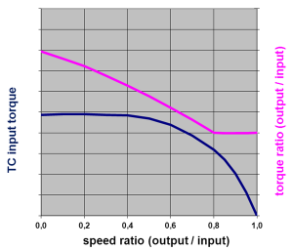
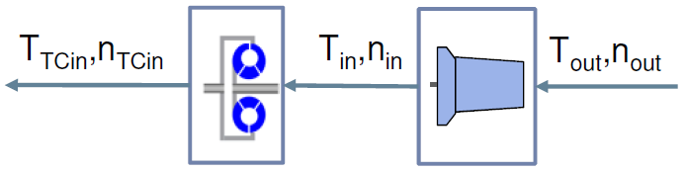
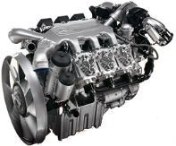
Torque Converter Calculation
Same polygon-based gear shift model as MT/AMT
Torque Converter (TC):
Defined as (virtual) separate gear, i.e. only first gear with TC active
While TC active: Iterative calculation of engine torque and speed based on TC characteristic
Creeping: Engine speed set to idling. Brakes engaged to absorb surplus torque
Torque converter characteristic (.vtcc file)
Quasi stationary backwards calculation
Transmission losses added
Longitudinal dynamics
Iteration
Engine
Torque converter
Transmission

Slide 40
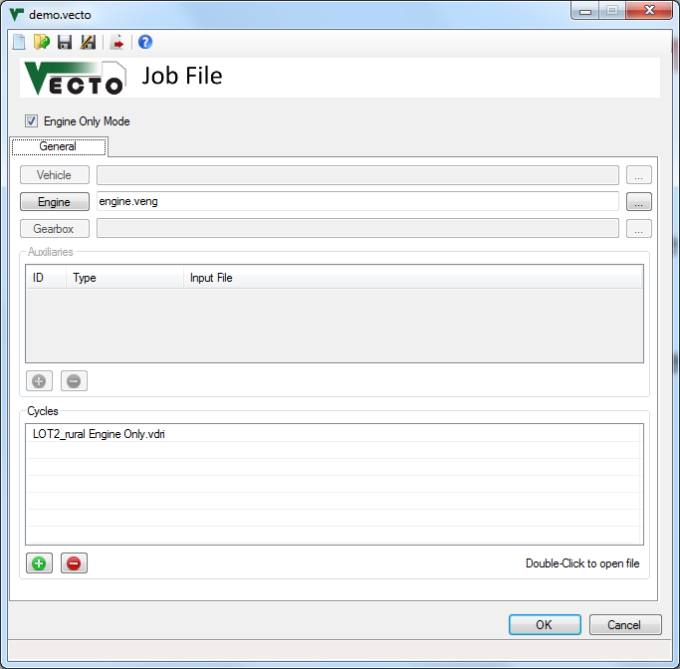
Engine Only Mode (.vecto file)
Calculate fuel consumption using a predefined load cycle
No gearbox, vehicle or Aux file required
Cycle format (see User Manual):
engine speed <n> [1/min]
engine power <Pe> [kW]
or
engine torque <Me> [Nm]
[Optional] Additional power demand (aux) <Padd>
Engine inertia (from .veng file) is added to the input torque!

Slide 41
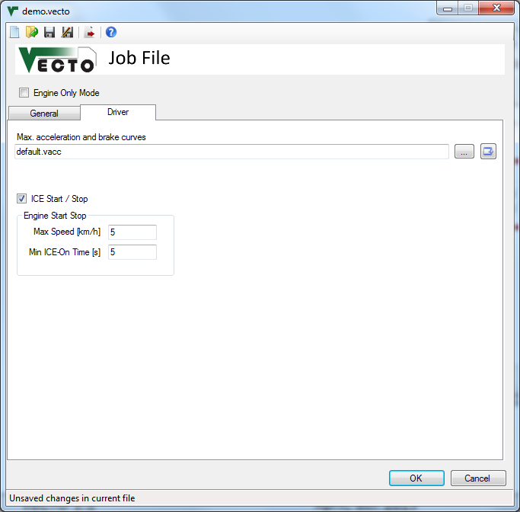
Engine Start / Stop (.vecto file)
Engine will be turned off if:
Power demand (without Aux) ≤ 0
Vehicle speed is below "Max speed [km/h]"
Engine was running for at least "Min ICE-On Time [s]"
TBD: Invalid auxiliary consumption work over cycle

Slide 42
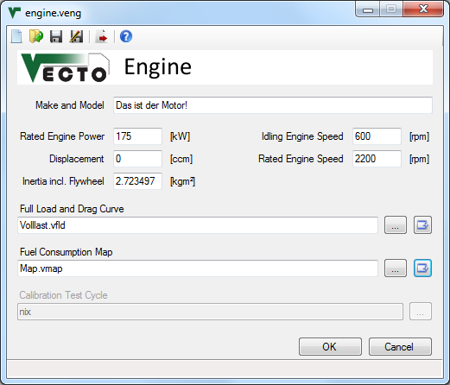
New "Open file" button
Opens a menu with three options:
Open with GRAPHi (see next slide)
Open with user-defined tool (see Settings)
Show in Folder (opens explorer)

Slide 43
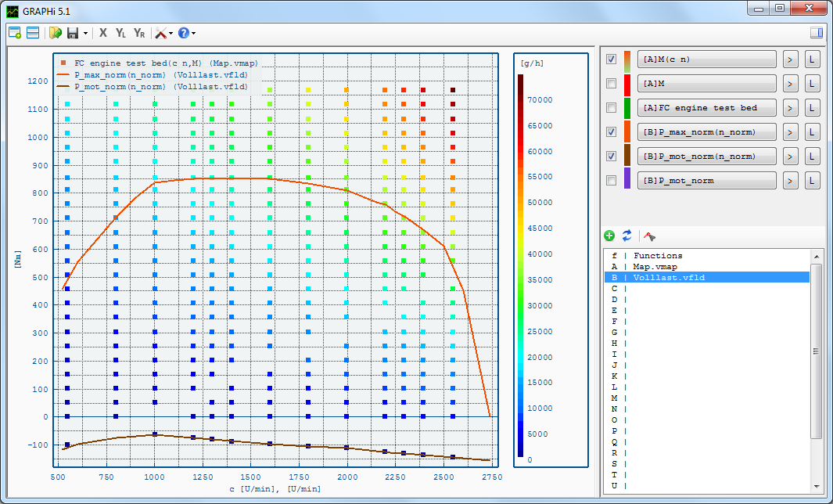
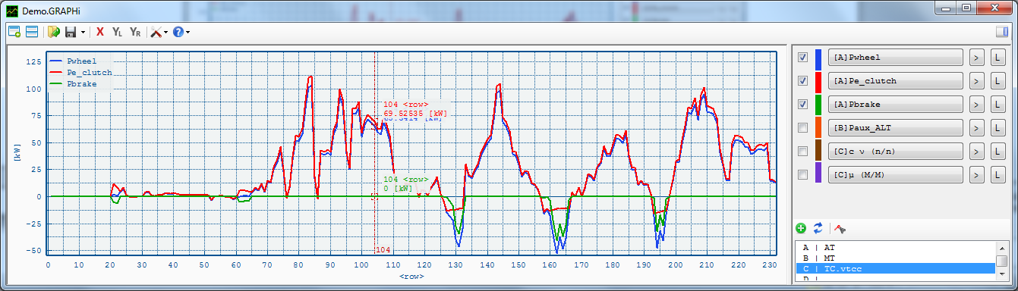
Visualizer (GRAPHi)
Independent 2D visualisation tool (see "GRAPHi" subfolder)
Supports CSV and MS Excel files
User Manual included ("?" button)
Located in "GRAPHi" subfolder
Note: GRAPHi is not a permanent part of VECTO and will be provided by TUG for a limited time only

Slide 44
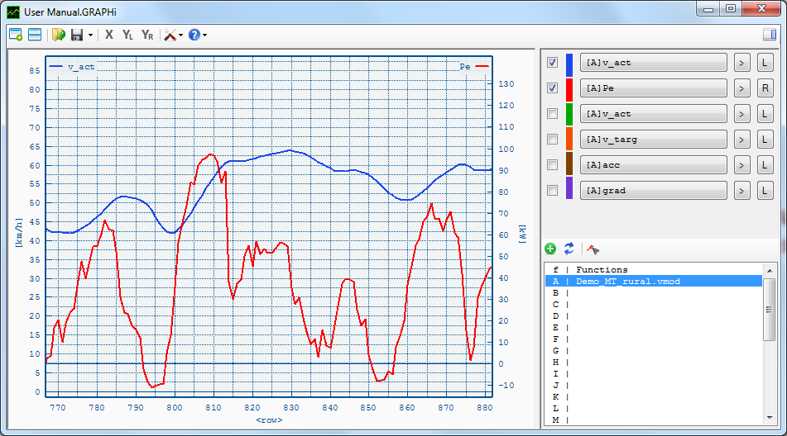
GRAPHi Quick Start (1/5)
Opening files
Use the "+" Button to add files (excel or csv)
Once a file is loaded, it remains in memory without accessing the file on the hard drive (unless manually reloaded).

Slide 45



GRAPHi Quick Start (2/5)
Mouse Controls
Move
[Drag&Drop]
Zoom
Zoom-Box
Click 1: 1st corner
Click 2: 2nd corner
(Right-Click to Cancel)
Hold cursor over x-axis to zoom/move x-axis only!!!

Slide 46
GRAPHi Quick Start (3/5)
Opening and Saving Sessions
Save/Load Session (.GRAPHi file)
Session files (.GRAPHi) include all data to restore a session. Source files are saved only as reference, i.e. the original files must be accessable.

Slide 47
GRAPHi Quick Start (4/5)
Windows and Syncing
Add Window
Sync open windows (x-axis, left and right y-axis)
Syncing means changes to the synced axes in one window are reflected by all other windows which have the same axes synced.

Slide 48
GRAPHi Quick Start (5/5)
User Manual
The User Manual can be opened here

Slide 49
Full Changelog V1.2
VECTO 1.2
Engine Start/Stop implemented
Bugfix: Fixed error in FC interpolation (invalid extrapolation errors)
FC Extrapolation will abort the calculation
Transmission Type selection in Gearbox (.vgbx) file.
Enables/Disables transmission type-specific options
In Proof-Of-Concept mode "Custom" type is available with all options enabled.
Automatic Transmission mode with Torque converter: Input parameters in Gearbox file !!still being tested!!
Option to open files with GRAPHi or user-defined tool
User Manual updated
Bugfix: Files with relative paths were not located correctly
Corrected comment line for wheels inertia and axle config in .vveh file
Changed RRC unit in GUI from [-] to [N/N]
Tranmission Loss Maps are not converted to n,Pe-Maps anymore. Should fix non-linear interpolation effects.
Engine Only Mode

Slide 50
VECTO 1.1 beta
05.02.2013
Update Notes

Slide 51
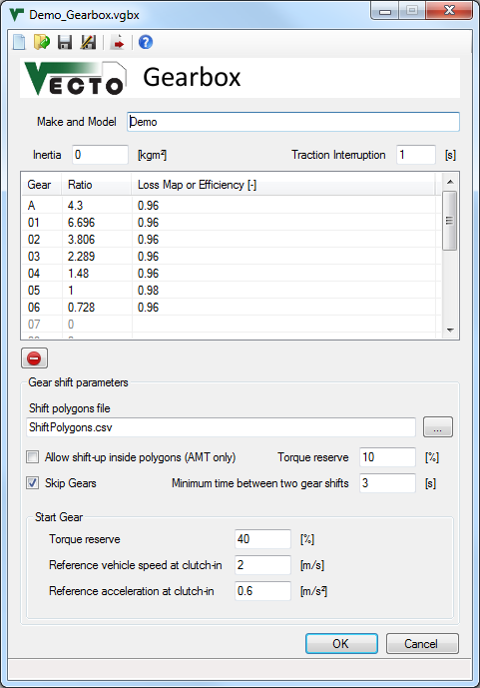
New gear shift model for MT and AMT
Overview:
Shifting based on used-defined shift polygons
Sequential shifting or gear skipping
Optional shifting inside polygons
Customisable start gear calculation

Slide 52
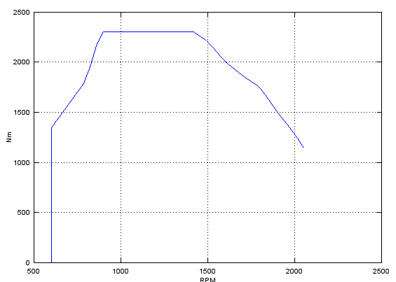
New parameters in .vgbx file
Shift polygons file:
CSV file* defining up- and downshift rpms over torque
File must cover full engine range including motoring
Two or more rows required
c Torque | Downshift | Upshift
c [Nm] | [rpm] | [rpm]
-500 | 650 | 900
0 | 650 | 900
500 | 700 | 950
... | ... | ...
Down-
shift
Upshift
*VECTO CSV Format:
List Separator: Comma ","
Decimal-Mark: Dot "."
Comments/headers: "c" at the beginning of the comment line. Number and position of comment lines is not limited.

Slide 53
New parameters in .vgbx file
Allow shift-up inside polygons (AMT):
Only if torque reserve is provided and rpm is still above Down-shift-rpm
Down-
shift
Upshift
Min % from max. positive torque at actual engine speed

Slide 54
New parameters in .vgbx file
Skip gears (AMT, MT):
Whenever gear shift is initiated (because rpm crosses up- or down- shift polygon) it is possible to skip gears
Torque reserve must be provided and rpm must remain below Down-shift-rpm
Down-
shift
Upshift
Min % from max. positive torque at actual engine speed

Slide 55
New parameters in .vgbx file
Minimum time between two gear shifts:
Limits the time between two gear shifts in whole seconds
Rule will be ignored if rpms are too high/low
High values may cause high rpms during acceleration

Slide 56
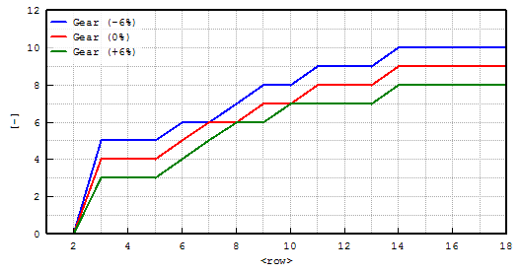
New parameters in .vgbx file
Start gear (first gear after vehicle standstill):
Calculated using a fictional load case with:
Reference speed
Reference acceleration
Actual road gradient, transm. losses and aux. power demand
independent from target speed
Example: Half-loaded articulated truck, 80km/h target speed:
downhill
uphill

Slide 57
Important notes
The demo data is updated for VECTO 1.1 and ready to run with the new gear shift model
Format of .vecto files has changed:
Old .vecto files (V1.0) can be used with VECTO 1.1.
New .vecto files (V1.1) can NOT be used with VECTO 1.0.
Format of .vgbx files has changed:
Old .vgbx files (V1.0) can be opened in the gearbox editor but gear shift parameters must be set before starting calculation.
New .vgbx files (V1.1) can be used with VECTO 1.0 but saving files will remove the new parameters.
The old gear shift model is NOT available in VECTO 1.1.
The User Manual and Quick Start Guide do not cover the new gear shift model yet.

Slide 58
Full Changelog V1.1 beta
VECTO 1.1 beta
- Speed values below 0.09km/h are set to 0km/h
- New gear shift model
- Replaces old gear shift model!
- New parameters in .vgbx file including path to gear shift polygons file
- Old gear shift model parameters removed from .vecto file
- Command Line Arguments processing (see User Manual):
- Changed prefix form "/" to "-"
- Bugfix: Argument "-run" was not processed
- Job files and driving cycles can be added via command line
- Files without path are expected in the Working Directory
- User Manual update for command line arguments
- Various fixes in GUI
- Bugfix: Error in Cycle Conversion (distance- to time-based) when using Aux Power Input.
- Distance Correction is now active only in acceleration and cruise phases.
- Fixed cycles starting with vehicle speed = 0. In V1.0 the first and second time step were averaged to speed values > 0.
- Demo data updated for new gear shift model
- New independent licensing dll replaces TUG's version

